Slide 1


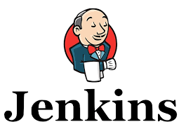








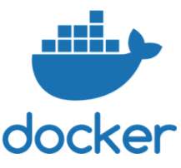

JENKINS PIPELINE
Builds image and Pushes image to ecr
Developers
(Image repository)
Pushes code
to git
Deploy image to ECS
Inside code
Plugin
Create load balancer
Link to cluster
cluster
Jenkins pulls code from
git
link to service
BDD and TDD
(Integrated test suit)
SonarQube
Analysis
(Goal)
Docker Build and
publish
(post build action)
Create task definition
Configure task definition
Create service
Build jar
Deploy
to container
Deployed Docker Images
in AWS ECS/ Fargate
Create container
Results of Analysis
(Code Quality)

Slide 2
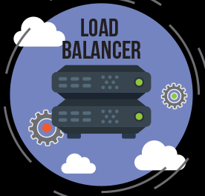
JENKINS PIPELINE
Build and
publish
plugin
Pushes code
Jenkins
Pulls code
Builds
jar
Sonar
Analysis
BDD and TDD
1
2
3
4
6
7
5
Analysis
Results
Build and
publish
Image
To ecr
8
Deploy to
ECS
9
Deploy
image
Load
balancer
Integrate
service
Create
service
Include into
cluster
Container
Task definition
service
13
12
11
10
14

Slide 3
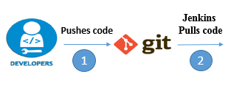
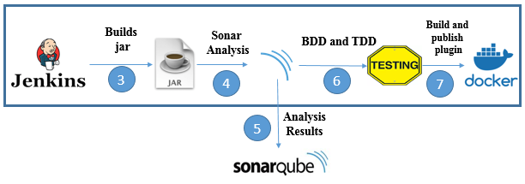
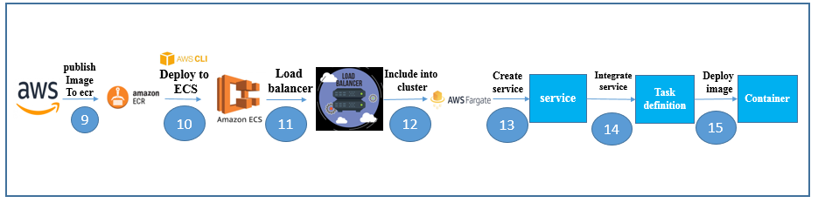
JENKINS PIPELINE
Build and
publish
Image
To ecr
8

